Slide 1

CSE 6389-001: Special Topics in Advanced Multimedia, Graphics, & Image Final Project
Flyn Sequeira, Shivam singh
University of Texas at Arlington
Instructor: Dr. Dajiang Zhu
Department of Computer Science and Engineering

Slide 2
What have we learned?
Identifying tech through research papers.
Understand cutting edge methods in Deep Learning and how it can be improved.
Familiarized with how the Brain works and research in Brain Image processing.
Importance of Clinical studies.
Reading the references or works cited may lead you to other useful resources.
Implementation of different algos with real world data set.
Developing a sense of Disciplinary Literacy and realizing its importance.
And finally, having a confidence of presenting a paper in future.

Slide 3
What have we learned?
Learnings from the paper assigned to me: “Cortical graph network for AD and mci diagnosis and transfer learning across populations”
Without research, there is no science; but without communication, research would grind to a halt.
Learned about the Spectral Graph CNN.
Learned about the importance of Transfer learning.
Importance of Cortical Thickness and its underlying geometric information for AD and MCI diagnosis and MCI-to-AD conversion.
Time long efforts by the researchers proposed a spectral graph-CNN model in this study which is relatively general and can be applied to other brain imaging data for the early diagnosis of brain disorders.
Great efforts by ADNI by collecting, maintaining and providing data.

Slide 4
What have we learned?
Understanding the intricacies of Brain Imaging and fMRI data.

Slide 5
What have we learned?
In depth understanding of how LSTM was modelled to distinguish subtle brain states.
LSTM has an inherent nature of understanding temporal data
We used LSTM and compared the results with CNN to demonstrate the power of either, with the temporal_fmri dataset.

Slide 6
dataset
Temporal fMRI Dataset from 150 regions of interest.
The dataset timesteps came in 3 ranges – 134, 191, 194
But this was true only for Patient Dataset, all healthy dataset were 191
Possible Reason for this – Many patients would have not had fMRI dataset after their demise.
We cropped every subject’s timestep at 134.

Slide 7
Deep learning architectures used
CNN
LSTM
Combined architecture of 1D-CNN and LSTM

Slide 8
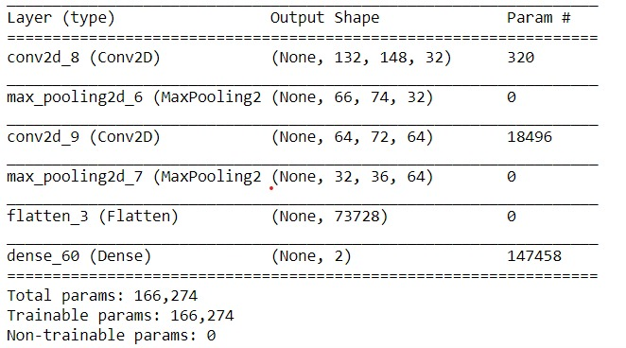
Deep learning architectures: CNN

Slide 9
Deep learning architectures: CNN
code

Slide 10
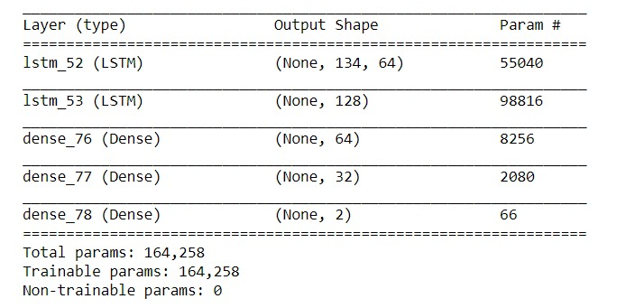
Deep learning architectures: lstm

Slide 11
Deep learning architectures: lstm
Code

Slide 12
Combined architecture: cnn with lstm

Slide 13
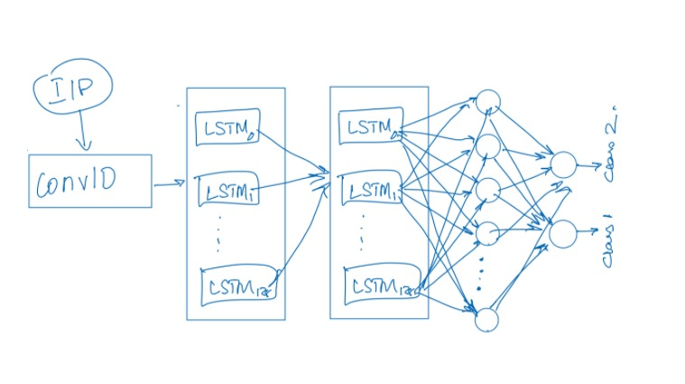
Combined architecture: cnn with lstm

Slide 14
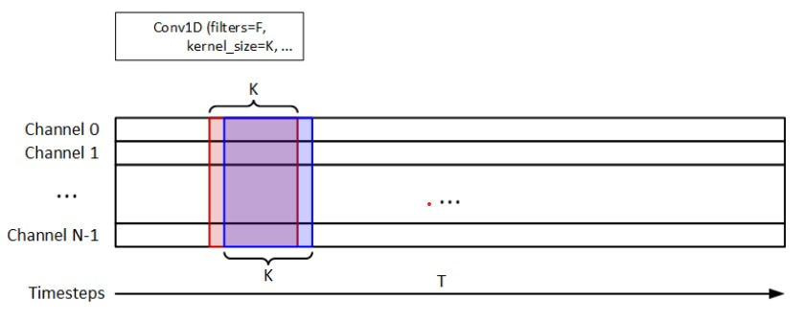
Combined architecture: cnn with lstm

Slide 15
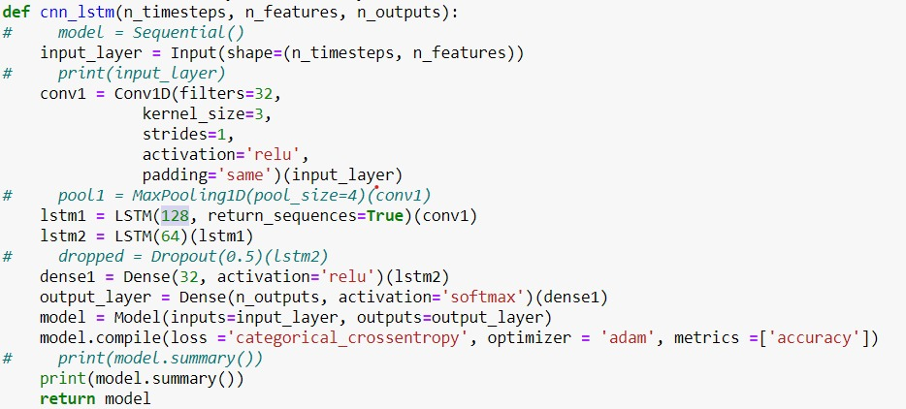
Combined architecture: cnn with lstm

Slide 16
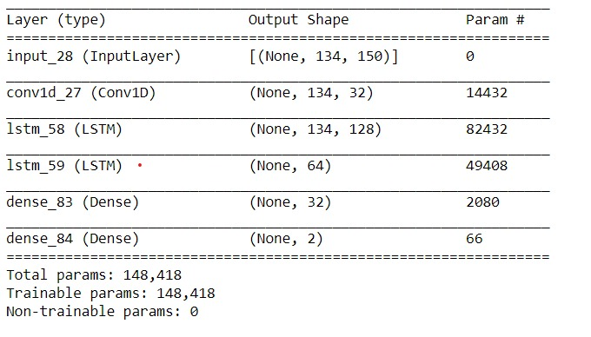
Combined architecture: cnn with lstm

Slide 17
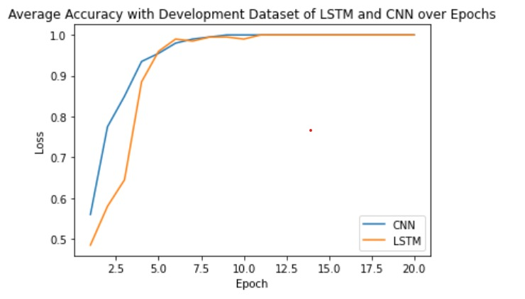
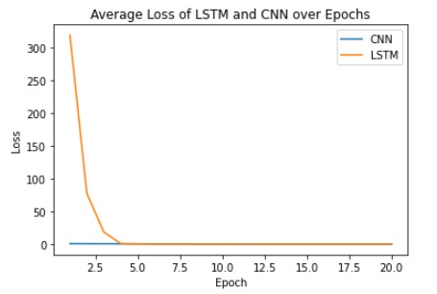
Performance comparisons: CNN & LSTM

Slide 18
Performance comparisons: CNN with LSTM
CNN with D1 and LSTM with D3
CNN + LSTM with D3

Slide 19
Results

Slide 20
CONCLUSION

Slide 21
Suggestions about the course
A tutorial lecture to develop a modus operandi for achieving a rapid, purposeful, effective and useful method to read these manuscripts.
A simple but efficient and logical approach to scientific literature for reading research papers systematically and effectively for a better understanding.
explaining how to look for intricacies in a good research paper, for Master’s students.
Like, how to read and make the best out of the mathematics in it?
Approach on how to implement a paper?

